Slide 1



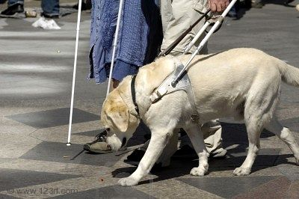
Providing accommodations for Students with Disabilities
Presented by the Houston Community College
Ability Services Offices

Slide 2
A quick note before we begin
Hello and thank you for reviewing this brief slideshow regarding HCC students with disabilities and in need of classroom accommodations.
This slideshow will focus on questions that HCC instructors may have regarding:
The Americans with Disabilities Act (ADA) and related laws.
Examples of accommodations typically provided.
The process students undergo for obtaining ADA accommodations.
Who to contact with any additional questions.
Common misconceptions about ADA accommodations.
What to look for when receiving an accommodations letter.
Reminders for instructors working with ADA students.
The presentation also provides a FAQ section for working with reasonable, classroom accommodations and sources for additional information.

Slide 3

About the laws
Other Laws and Regulations
Federal Communications Commission (FCC) regulations and the Health Insurance Portability and Accountability Act (HIPAA) of 1996 also play a role in reasonable classroom accommodations.
For questions regarding ADA and related laws, a list of resources is given at the end of this slideshow.
ADA and ADAAA
According to the Americans with Disabilities Act (ADA) of 1990 and the ADA Amendments Act (ADAAA) of 2008, qualifying, disabled students are provided reasonable, classroom accommodations when requested.
Notes:
Simply glancing at the letter and saying something such as, “Ok” may be misinterpreted by a student as a dismissal.

Slide 4



Typical accommodations
So what are some common examples of REASONABLE accommodations?
Extra time on tests.
Extra time to complete IN CLASS written assignments.
Preferred classroom seating.
Testing in a distraction-reduced environment.
A sign-language interpreter in the classroom.
Use of a service dog in the classroom.
Note: The list of reasonable accommodations is NOT limited to merely these examples.

Slide 5

How do ADA students receive accommodations?
ADA students meet with an Ability Services Counselor at their college. If your student reports that he/she has a disability but is unsure about accommodations, direct him/her to your college’s Ability Services Counseling office.
Students who qualify for ADA accommodations receive an accommodations letter from their Ability Services Counselor. Students must return to Ability Services each semester for an updated letter.
Students submit an e-mailed copy of their letter to EACH of their instructors as soon as possible; ideally at the start of the semester.

Slide 6
What about ADA students taking HCC Online courses?
HCC Online students with qualifying disabilities must still meet with an Ability Services Counselor.
Accommodation letters prepared the same way and emailed to the student. It is the student’s responsibility to e-mail the accommodation letter to the Online Instructor through Canvas or instructor’s documented preferred manner.

Slide 7
Additional notes for Online Instructors
Online students WITHOUT ADA specific testing accommodations
Online students WITH ADA testing accommodations
Students WITHOUT ADA specific testing accommodations can test at the Online testing locations. They can still obtain the extended time if they show up with the accommodation letter with enough time to test.
Students WITH ADA specific testing accommodations (Reader/Scribe, CCTV, distraction reduced, etc.) can test at any of the college campus testing centers.
Your Instructional Support Specialist at 3100 Main can help set up testing arrangements for you and your students (times, dates, location, test drop off and pick up).
https://www.hccs.edu/online/proctoring-services/Your Instructional Support Specialist at 3100 Main can help set up testing arrangements for you and your students (test drop off and pick up).

Slide 8

Who are the Ability Services Counselors?
Central Campus
Jette Lott & Senta Eastern 713-718-6164
Northeast Campus
Cynthia De Los Santos 713-718-8322
Northwest Campus
Lisa Parkinson (Spring Branch) 713-718-5422
Southeast Campus
Tavia James 713-718-6738
Southwest Campus
Dr. Becky Hauri (West Loop) 713-718-7909
Coleman Campus
Brandy Lerman 713-718-7376
VAST Program
Sue Moraska 713-718-6833
Dr. LaRonda Ashford (Katy) 713-718-5408
Greta Brooks (Stafford) 713-718-7448
Dr. Estelle Sit (Alief) 713-718-7053

Slide 9

Common misconceptions about accommodations
“Accommodations give students an unfair advantage.”
REASONABLE accommodations are about ACCESS to classes, resources & instruction. They are about leveling the playing field and NOT about guaranteeing success or getting an unfair advantage.
“ADA students don’t have to work as hard as others.”
Just like traditional students, ADA students:
must complete their assignments.
must attend classes.
are not allowed to disrupt/monopolize class time.
cannot harass/threaten instructors or their fellow students.
are still responsible for their tuition, books, coursework, schedules, etc…..

Slide 10
Common misconceptions about accommodations
“Instructors can ‘pick and choose’ which accommodations students get.”
NO. All accommodations are to be followed as listed on the student’s accommodations letter. However, you can always contact your Ability Services office with any concerns.
“My student looks, just fine. He doesn’t have a cane, brace or wheelchair so he must be ok.”
Some disabilities are “hidden”. They are not readily visible but still present:
Students may have cognitive or psychological disabilities that are not easily detected by just looking at them.

Slide 11
Receiving an accommodation letter
I received an accommodation letter from a student. What should I look for when reviewing the letter?
Student name.
Student ID number.
The appropriate HCC college that created the letter (Except for HCC Online).
The appropriate term.
See next panel for an example.

Slide 12
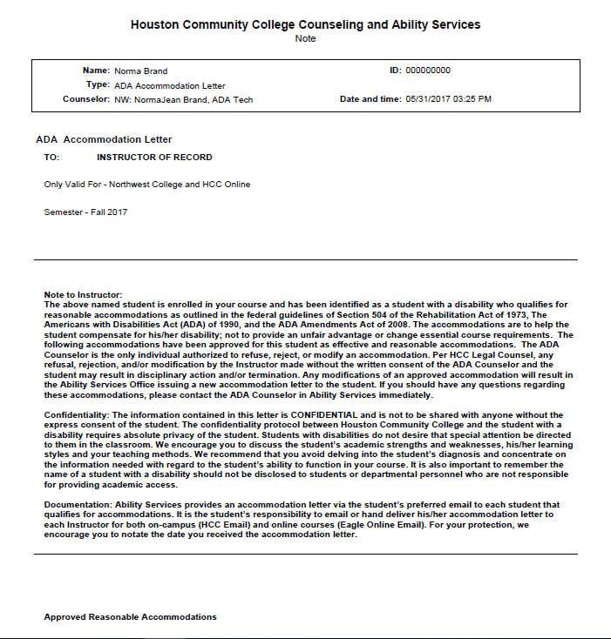

Sample Accommodation letter
Check for the student’s name and ID number.
Check the college location. Note the name of the counselor who prepared the letter.. Make sure you contact that counselor if you have any questions or concerns.
Check the term on the letter. Accommodation letters are semester specific and time bound. The letter must be for the current semester or summer session.

Slide 13
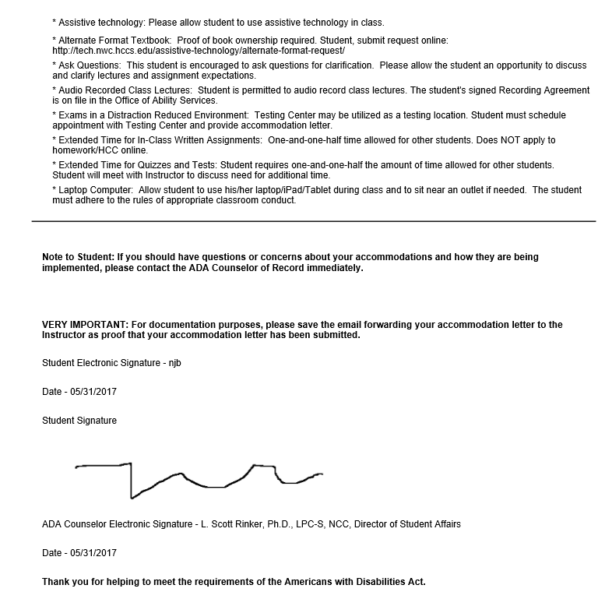
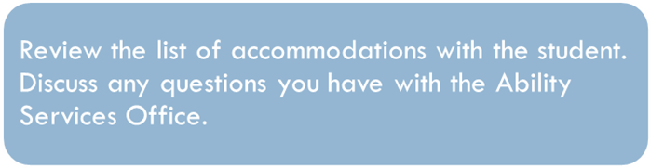


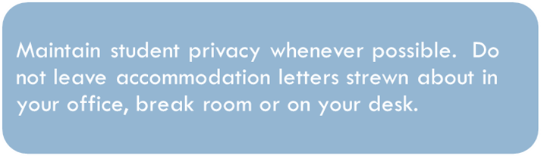

Slide 14

Reminders for instructors
Students must self-identify as a disabled student. Faculty and staff CANNOT ask students if they are disabled.
Instructors should not provide accommodations until they receive an accommodations letter prepared by the Ability Services Office.
Instructors should encourage students to submit their letter at the start of the semester and at a time and place where privacy can be maintained (during office hours or before/after class).

Slide 15
Reminders for instructors
Accommodation letters are time bound. Example: A letter prepared for spring courses cannot be used for fall classes. Students must present a letter specific to that semester or summer session.
A note/reminder about ADA accommodations should be included on your syllabus. Please remind students about ADA accommodations at the start of each semester.
Online instructors may receive accommodation letters created at any HCC campus. It is the student’s responsibility to email the accommodation letter to the Instructor.

Slide 16

Reminders for Instructors
“What should I say when meeting with an ADA student?”
Assuming a student self-identifies as an ADA student, you may need to have a private conversation with him/her about:
How the disability may affect his/her performance/attendance in class.
Exactly what steps each of you will take to meet the accommodations.
Expectations required for academic success such as completing assignments, attending class, etc…..(be specific).

Slide 17

Reminders for DE instructors
The Blackboard/Eagle Online instruction software can be modified by an instructor to lengthen the amount of time given to a specific student for testing.
If uncertain about how to provide accommodations for an online course contact the your Ability Services Office.
If unsure how to modify the test time online call 713-718-5275 and select option #3 (during typical office hours). Instructors can also complete the online help form at https://online-03.hccs.edu/Vista_Admin/
Notes:
Please refer to your Blackboard Training manual or contact your college IDC or DE Tech Support at 713-718-5275 option 3. You may also use the following link for help: http://de.hccs.edu/de/de-faculty-staff/blackboard-problems-to-refer-directly-to-hcc-support-staff/links/college-idcs-and-bb-vista-administrators

Slide 18

FAQ
An ADA student provides an accommodation letter several weeks AFTER the semester began. He states that he should be allowed to retake an exam he already took a week ago; but this time WITH accommodations. Do I have to allow him to retest?
NO. An Instructor cannot provide reasonable accommodations until the student has submitted his accommodation letter.

Slide 19

FAQ
I received an accommodation letter from a student. It says he needs additional time to complete “in class written assignments.” Does that include homework assignments?
NO. The letter clearly states it applies to assignments that are to be completed during class time only.

Slide 20

FAQ
A student’s accommodation letter says she must test in a, “distraction reduced” environment. How can I accomplish that?
Options include:
Ask your campus Testing Department to see if it can provide a distraction reduced environment. If so, make arrangements with the Testing Associate in advance.
Have the student test in a separate room (a tutoring center or nearby conference room may suffice if available).
NOTE: A stairwell or hallway is NOT an ideal setting for a distraction reduced environment.
DE instructors work with their instructional support specialist if testing on-site.

Slide 21

Final Notes
When meeting with a student, make a note and be specific (note dates, times, methods used, etc…)
Example: Met with student in my office (room 301B) on (Date) at (Time). Student submitted his accommodation letter indicating he needs additional time to complete exams and must test in a distraction reduced environment. Student agreed to take exams at the Central Campus Testing Center (LHSB Room 211). Tests to be proctored by Testing Office personnel. Testing accommodation arrangements have been made with Testing Office personnel. Tests will be given on test dates outlined in syllabus. Student is to be given 1.5 times the amount of time given to other students. Student acknowledged arrangements made with Testing Office. Student agrees he is responsible for taking his tests per arrangements with Testing Office.

Slide 22

Additional Resources
Thank you for reviewing this presentation. We hope to have answered your questions regarding ADA accommodations. We also encourage you to contact your Ability Services Office with any additional questions or concerns.
For additional information, you may also review the following resources:
http://www.hhs.gov/ocr/privacy/http://www.ada.gov/index.html
http://www.ada.gov/index.html
http://www.hhs.gov/ocr/privacy/

